Slide 1
CHAPTER 2
LIMITS AND CONTINUITY

Slide 2
CONTENTS
2.1. The Tangent & Velocity Problems
2.2. The Limit of a Function
2.3. Calculating Limits using the Limit Law
2.4. Continuity
2.5. Limits involving Infinity

Slide 3
2.4. CONTINUITY
2.4.1. Definition of Continuity
2.4.2. Continuity of Familiar Functions
2.4.3 The Intermediate Value Theorem

Slide 4
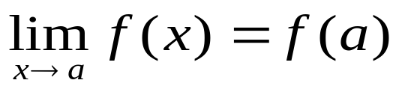
2.4.1 Definition of Continuity
Definition. A function f is continuous at a
number a if
If f is not continuous at a, we say that f is discontinuous at a or f has a discontinuity at a
A continuous function f has the property that small change in x produces small change in f(x)

Slide 5
Geometrically, the graph of a continuous function has no break. It can be drawn without removing the pen from the paper
But discontinuity also occurs in such situation as electric current: the Heaviside function is discontinuous at 0
Physical phenomena are usually continuous: the displacement or velocity of a car, a person’s height.

Slide 6
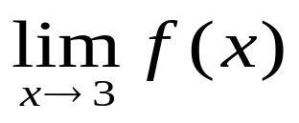
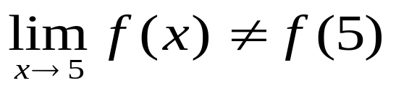
Example. f is given by the following graph. Where is f discontinuous? Why?
Solution. f is discontinuous at x =1 since f(1) is not defined
f is discontinuous at x =3 since does not exist
Finally, f is discontinuous at x =5 since
1
3
5

Slide 7
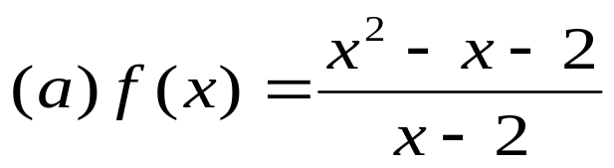
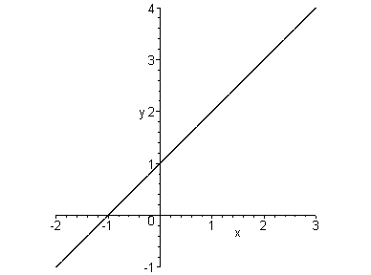
Example. Where are each of the following functions discontinuous?
Solution.
(a) f is discontinuous at x =2 since f(2) is not defined.

Slide 8
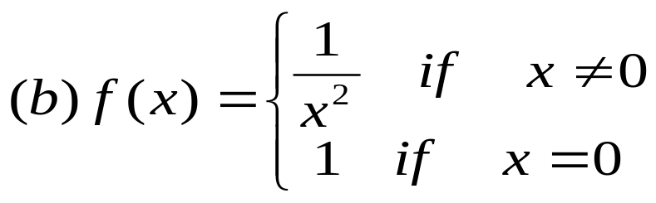
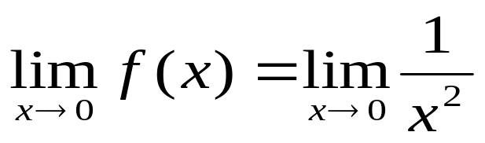
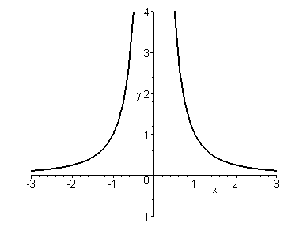
Solution. (b) f is discontinuous at x =0 since
does not exist.

Slide 9
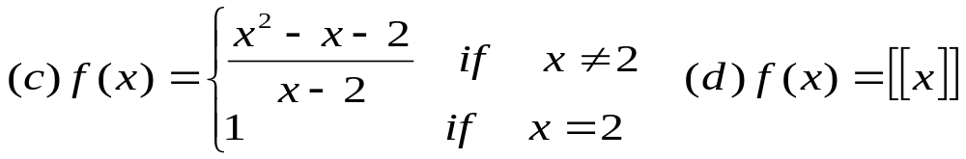
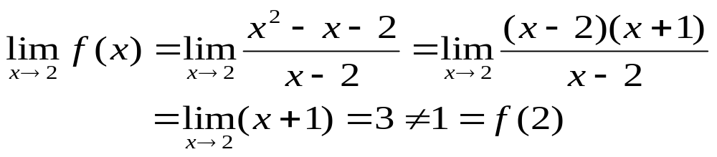
Solution. (c) f is discontinuous at x =2 since

Slide 10
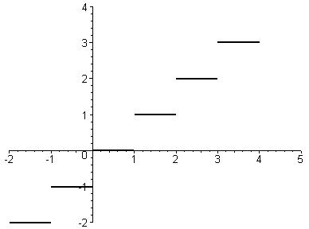
Remark.
The discontinuity in (a) and (c) are removable since we can define the value of f at x = 2 to obtain a continuous function
The discontinuity in (b) is an infinite discontinuity
The discontinuities in (d) are jump discontinuities

Slide 11
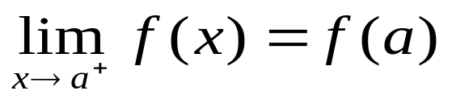
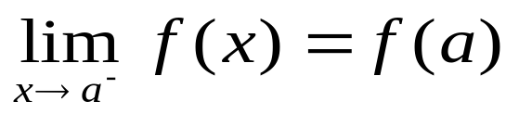

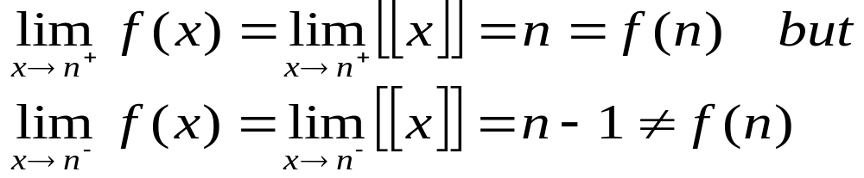
Definition 2. A function f is continuous from the right at a number a if
and f is continuous from the left at a if
Example. The function is continuous from the right but discontinuous from the left since

Slide 12
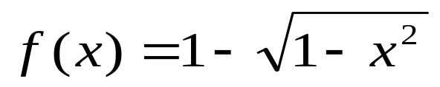
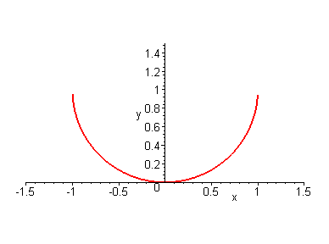
Definition 3. A function f is continuous on an interval if it is continuous at every point in the interval.
(if the point is only an end point, we understand the continuity at that point to be one-sided)
Example. Show that the function is continuous on the interval [-1,1]

Slide 13
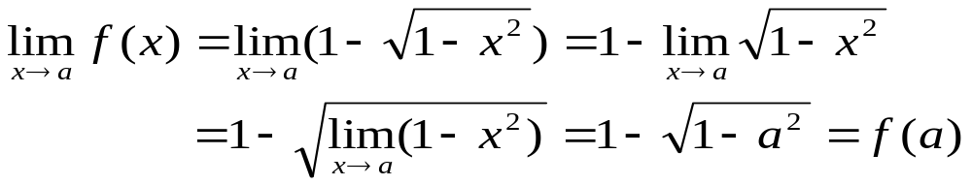
Solution.
If –1 < a <1 then f is continuous at a since
Similar calculations also show that
Therefore f is continuous from the right at –1 and from the left at 1.
Hence f is continuous on [-1, 1]

Slide 14
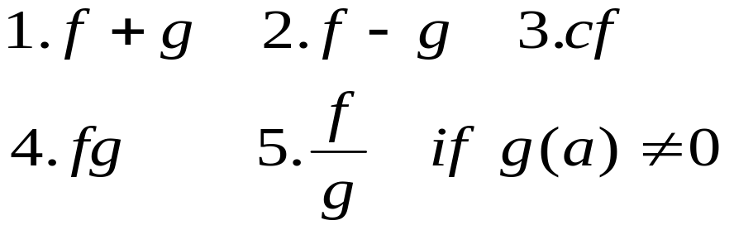
2.4.2 Continuity of Familiar Functions
The following Theorem is useful in proving the continuity of familiar functions
Theorem 4. If f and g are continuous at a and c is a constant, then the following functions are continuous at a

Slide 15
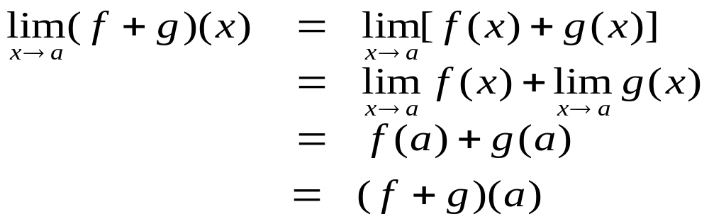
Proof. We will prove the continuity of f + g. The other properties are proved similarly.
First of all from the continuities of f and g we have
Therefore
Hence f + g is continuous at a

Slide 16
Corollary. If f and g are continuous on an interval I then f + g, f – g, fg and f / g (if g does not vanish on I) are also continuous functions on I.
From the Corollary we also have
Theorem 5.
Any polynomial is continuous everywhere, i.e. on R
Any rational function is continuous on its domain
From the Theorem 5 we can evaluate some limits very quickly

Slide 17
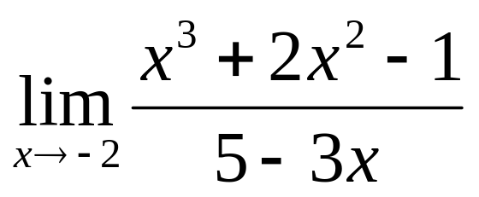
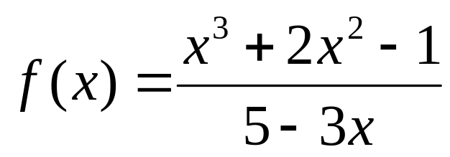
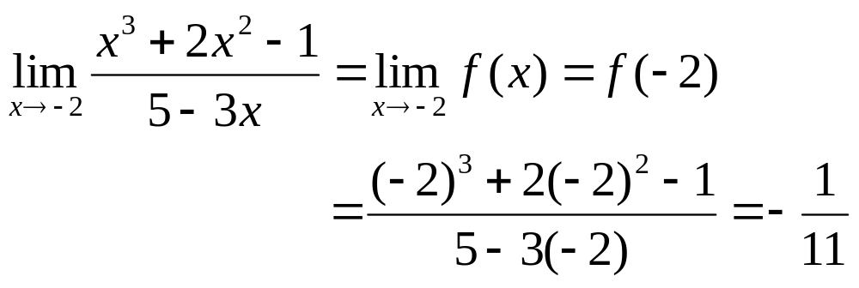
Example. Find
Solution. The rational function is continuous on {x / x ≠ 5/3}.
Therefore

Slide 18
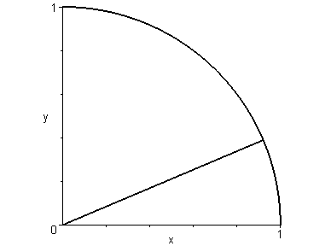
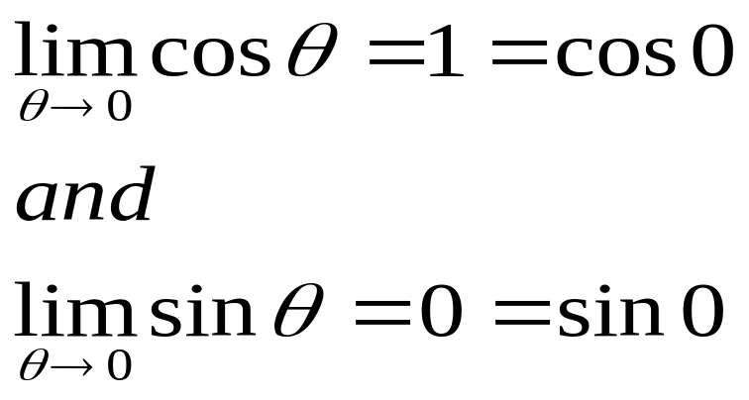
As θ approaches 0, P approaches the point (1, 0). Then cosθ approaches 1 and sinθ approaches 0. We have
sinθ
P
θ
cosθ
It follows that the functions cosθ and sinθ are continuous at 0.

Slide 19
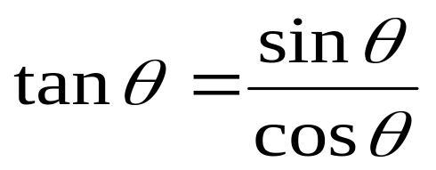
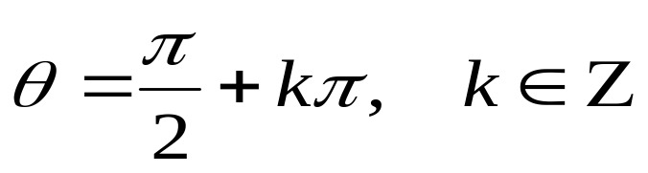
Exercise. Prove that cos θ and sin θ are continuous at any point θ₀
The function tan θ is defined by
Therefore it is continuous on R
except at the points
Finally we admit the continuity of other type of familiar functions as indicated in the following Theorem

Slide 20
Theorem 6. The following type of functions are continuous at every point in their domains
polynomials rational functions
root functions
trigonometric functions
inverse trigonometric functions
exponential functions logarithmic functions

Slide 21
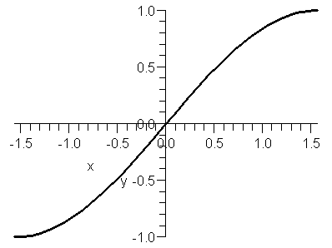
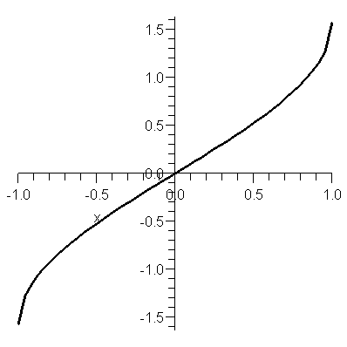
Inverse trigonometric functions
sin^{–1}x. The function sin x is continuous on R but not one-to-one. However if we restrict it to [–π/2 , π/2], we will get a one to one function from this interval to [–1, 1].
Therefore the inverse function sin^{–1} x exists and is a continuous function from [–1, 1] to [–π/2 , π/2].
This function is also denoted by arcsin x

Slide 22
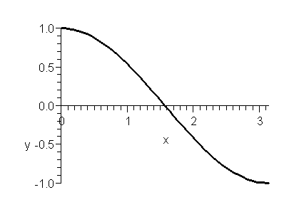
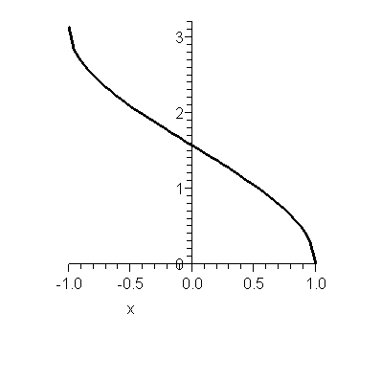
Inverse trigonometric functions
cos^{–1}x. Similarly the function cosx is a one-to-one function from [0, π] with the range [–1, 1].
Therefore the inverse function cos^{–1}x exists and is a continuous function from [–1, 1] to [0, π].
This function is also denoted by arccos x

Slide 23
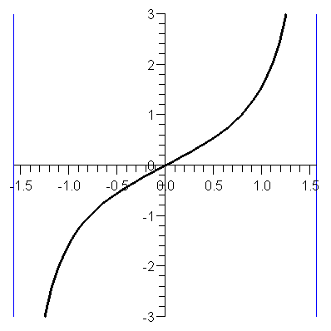
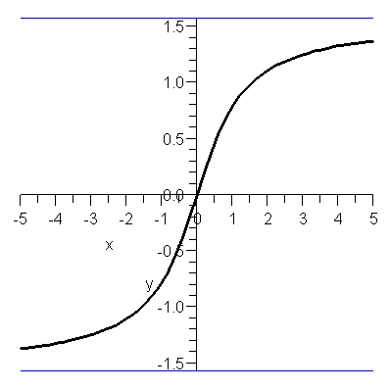
Inverse trigonometric functions
tan^{–1}x. The function tanx is a one-to-one function from (–π/2 , π/2) with the range (–∞, ∞).
Therefore the inverse function tan^{–1} x exists and is a continuous function from (–∞, ∞) to (–π/2 , π/2)
This function is also denoted by arctan x

Slide 24
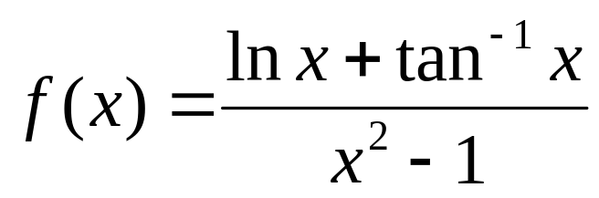
Example. Where is the function continuous?
Solution. The numerator is continuous on (0, ∞).
The denominator is continuous on R and vanishes at 1 and –1.
Hence f is continuous on the intervals (0, 1) and (1, ∞).

Slide 25
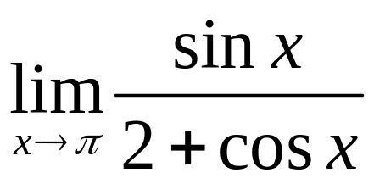
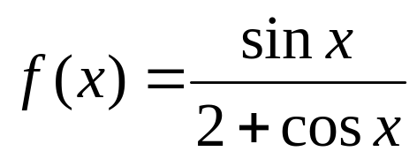
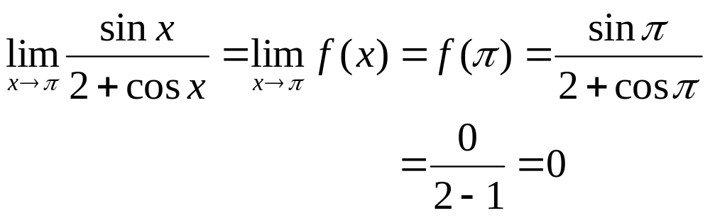
Example. Evaluate
Solution. The numerator is continuous on R.
The denominator is continuous on R and never vanishes.
Hence the function is continuous on R.
Therefore

Slide 26
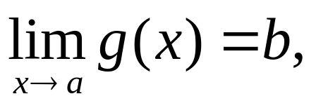
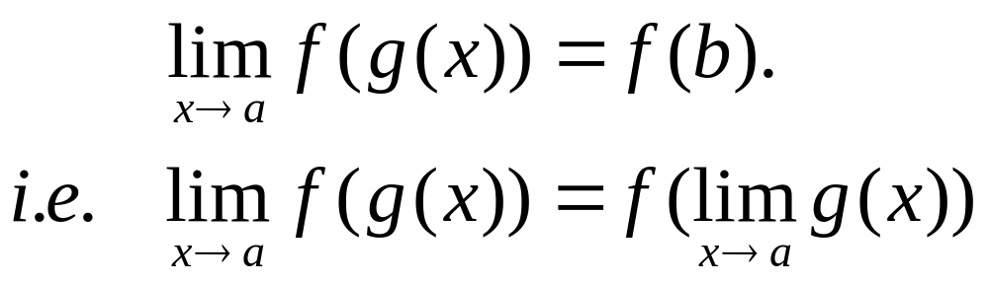
Theorem 6. If f is continuous at b and then

Slide 27
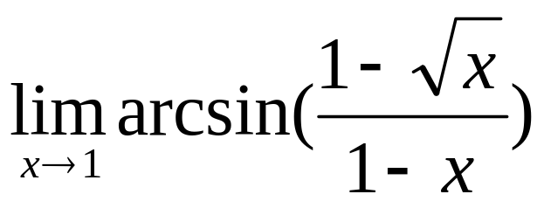
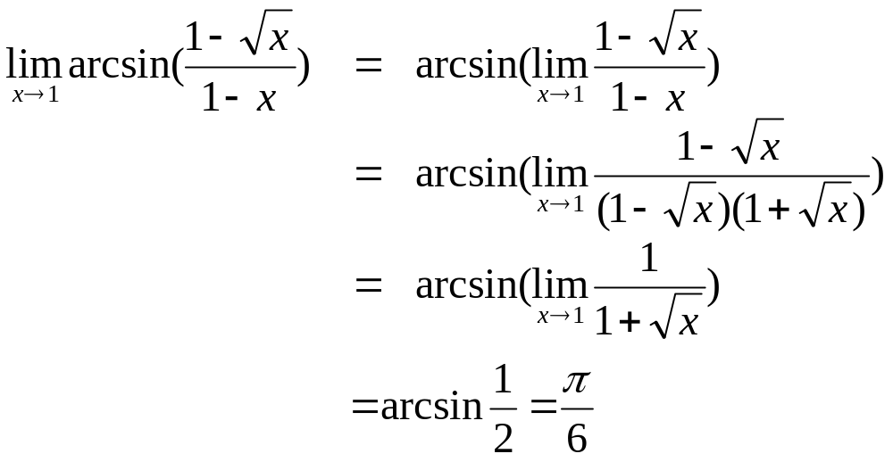
Example. Evaluate
Solution. Because arcsin is a continuous function on [–1, 1], Theorem 8 gives

Slide 28
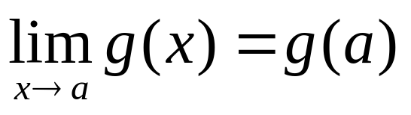
Theorem 9. If g is continuous at a and f continuous at g(a) then f o g is continuous at a
Proof. Since g is continuous at a we have
Since f is continuous at g(a), Theorem 8 gives
i.e. f o g is continuous at a

Slide 29
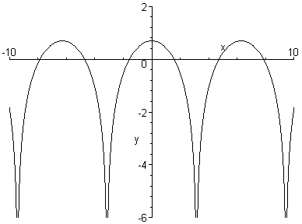
Example. Where are the following functions continuous
(a) h(x) = sin(x²) (b) F(x) = ln(1+cos x)
Solution. (b) f(x) = ln x is continuous for x > 0, and g(x) = 1 + cos x is continuous on R, therefore by Theorem9 F = f o g is continuous wherever it is defined, i.e. at x such that 1 + cos x > 0 or cos x ≠ –1. Hence F(x) is continuous on R except the points x = π + 2kπ, k∈Z

Slide 30
2.4.3. The Intermediate Value Theorem
Theorem 10. (The Intermediate Value Theorem) Suppose f is continuous on the close interval [a, b] and let N be any value between f(a) and f(b).
Then there exists a number c in [a, b] such that f(c) = N.
f(b)
f(b)
N
N
f(a)
f(a)
a
c
b
a
c₁
c₂
c₃
b

Slide 31
Example. Show that there is a root of the equation
4x³ – 6x² + 3x – 2 = 0
between 1 and 2
Solution. Let f(x) = 4x³ – 6x² + 3x – 2 .
We shall prove that there exists c∈[1, 2] such that f(c)=0
Since f is continuous on R, to apply Theorem10, we need to show that 0 lies between f(1) and f(2).
We have indeed
f(1) = 4 - 6 + 3 - 2 = -1 < 0
and f(2) = 32 - 24 + 6 - 2 = 12 > 0

Slide 32
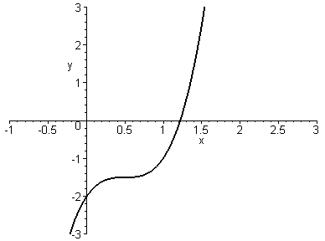
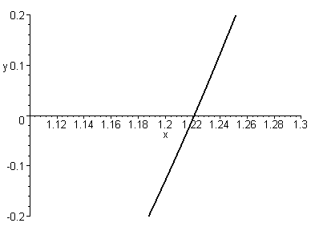
From the picture on the left we see that there is some root in the interval (1.1, 1.3).
Therefore we can zoom in the rectangle [1.1, 1.3] × [–0.2, 0.2]
and find that 1.2 is a root exact to 1 decimal place

Slide 33
When using the graph to solve an equation, we trust that the graph of f(x) with two end points lying on two sides of a horizontal line always intersects the line
This is exactly the content of the Intermediate value Theorem if f is continuous.
Of course the Theorem is false if f is not continuous as shown by the following graph
f(b)
N
f(a)
a
b

